Slide 1

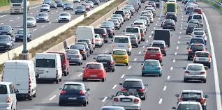
SC Department of Alcohol & Other Drug Abuse Services (DAODAS)
Quarterly Prevention Meeting, November 7, 2019
Terecia W. Wilson, Professor of Practice & Assistant Director
Institute for Global Road Safety and Security
Clemson University
Road Safety Professional (RSP)

Slide 2

Goals
  To recognize road safety as a profession
  To establish a recognized level of practice and knowledge
  To incentivize safety education
  To support public safety initiatives such as Toward Zero Deaths, Vision Zero, and Road to Zero
Notes:
40,000 lives are lost annually on U.S. and Canadian highways.
Initiatives such as Toward Zero Deaths, Vision Zero, and Road to Zero seek to improve public safety
RSP certification represents important step forward for the safety profession to recognize road safety as a profession in its own right.
The RSP will establish levels of competency for professionals working in the field.
We hope that it will also serve as a incentive to include safety coursework in university curriculum and as well as fostering continuing safety education.

Slide 3
Background
Developed by Transportation Professional Certification Board (TPCB)
Supported by many U.S.- and Canada-based transportation- and safety-related organizations
Administered by Castle Worldwide, a recognized certification and licensure testing company
Partially funded through Federal Highway Administration (FHWA) and National Highway Traffic Safety Administration (NHTSA)
Notes:
TPCB was established in 1998 by the Institute of Transportation Engineers to provide a vehicle for transportation certifications.
TPCB has two existing certifications – Professional Transportation Operations Engineer (PTOE) and Professional Transportation Planner (PTP)
Certification development guided by a steering committee representing a wide range of transportation and safety organizations in the US and Canada
This steering committee identified target audience, prerequisites, draft domains and subdomains of knowledge and preliminary list of references as well as subject matter experts
Developed over 9-months through an industry-standard process with oversight and guidance by Castle Worldwide

Slide 4
Background
Transportation Professional Certification Board (TPCB) established in 1998
Provides a mechanism to create and administer professional certifications for those involved in the practice of transportation
First certification was the Professional Traffic Operations Engineer (PTOE) in 1999 – today more than 3,000 PTOE’s
Second certification was Professional Transportation Planner in 2007 – today more than 400 PTP’s
Third certification is the Road Safety Professional (RSP), Level One and Level Two, established in 2018
Notes:
TPCB was established in 1998 by the Institute of Transportation Engineers to provide a vehicle for transportation certifications.
TPCB has two existing certifications – Professional Transportation Operations Engineer (PTOE) and Professional Transportation Planner (PTP)
Certification development guided by a steering committee representing a wide range of transportation and safety organizations in the US and Canada
This steering committee identified target audience, prerequisites, draft domains and subdomains of knowledge and preliminary list of references as well as subject matter experts
Developed over 9-months through an industry-standard process with oversight and guidance by Castle Worldwide

Slide 5
Need for Certification Program
Build professional capacity
Create a highly skilled road safety workforce
Produce competent and capable professionals
Implement new tools and technologies
Learn to work in Multidisciplinary teams
Utilize evidence-based approaches

Slide 6

Benefits of Certification
For Individuals
For Employers
Keeps you relevant and current
Increases job security
Advances your career development
Secure higher salary
Demonstrates your credibility and proficiency
Competitive advantage in market place
Increases customer confidence in your team
3rd party endorsement of your team’s knowledge, skills, and training
Documented commitment to excellence
Notes:
Why RSP?
For individuals - it provides recognition for of your knowledge and skills. The continuing education requirements help keep your current. Better skills and recognition = more rewards.
For employers – it distinguishes you from your competitors, it provides more confidence in your team, it demonstrates a commitment to excellence.

Slide 7

Level 1 Exam: Background
Demonstrates expertise in road safety’s multidisciplinary dimensions
For any professional who in the performance of their work makes decisions or takes actions that potentially impact the safety of the traveling public
Notes:
RSP is being developed as a two-level certification.
RSP Level 1 is designed to demonstrate expertise in road safety’s multidisciplinary dimensions.
The target audience is any professional who in the performance of their work impacts the safety of the traveling public.

Slide 8
Level 1 Exam: Audience
Policy & Regulation
Research & Education
Planning & Design
Data Collection and Analysis
Emergency Response & Crash Investigation
Program Administration & Operations
Notes:
The audience is very broad and includes individuals in all aspects of transportation and safety.

Slide 9
Level 1 Exam: Pre-Requisites
Bachelor’s degree from accredited university and minimum of two (2) years’ experience transportation, highway safety or public health
OR
minimum of four (4) years’ experience transportation, highway safety or public health
Notes:
Applicants must have either:
Bachelor’s degree and two years experience in transportation, highway safety or public health
OR
- Minimum of four years experience in transportation, highway safety or public health.

Slide 10
Level 1 Exam: Structure
Three (3) hours
75 Multiple-Choice Questions
Qualitative
Notes:
The exam is completed electronically at designated testing centers during three testing periods annually – February, June and October.
The RSP Level 1 exam will be a 3-hour, 75 multiple choice question exam. The questions will all be qualitative in nature.

Slide 11
Level 1 Exam: Content Outline Domain Overview
Foundations of Road Safety
Measuring Safety
Human Behavior and Road Safety
Solving Safety Problems
Implementing Road Safety Programs

Slide 12
Level 1 Exam: Fees
Application/Examination Fee: US $100
Three-Year Certification Fee: US $180 (US $60/year)
Discounts provided for existing PTOE/PTP certification holders
Notes:
Applicants must submit and application detailing their experience. The application will be available at TPCB.org starting June 15.
There is a $100 non-refundable application/examination fee along with $180 fee covering initial 3-year certification fee. The certification fee is refundable if the individual does not pass the exam.
The RSP certification fees will be discounted for PTOE and/or PTP certification holders.

Slide 13

Level 2 Exam: Background
Higher level certification demonstrating deeper level of understanding and proficiency in road safety science
Any professional whose primary job functions are directed at improving the road safety performance
Two options:
  Behavioral
  Infrastructure
Notes:
RSP Level 2 is underdevelopment.
The target audience is professionals whose primary job functions are directed as improving road safety performance.
There will be two specialty areas to choose from:
Behavioral
Infrastructure

Slide 14
Level 2 Exam: Pre-Requisites
Successful completion of Level 1 exam
AND
Bachelor’s degree from an accredited university and minimum of five (5) years experience in transportation, highway safety or public health
OR
minimum of ten (10) years experience transportation, highway safety or public health
Notes:
Applicants for the RSP Level 2 exam must have completed the RSP Level 1 exam or be taking the RSP Level 1 exam concurrently and pass it.
Applicants must have:
A bachelor’s degree and 5 years experience in transportation, highway safety or public health
OR
10 years experience in transportation, highway safety or public health.

Slide 15
Level 2 Exam: Structure
Three (3) hours
75 Multiple-Choice Questions
Qualitative and Quantitative
Notes:
The RSP Level 2 Behavioral and Infrastructure Exams will be similar to RSP Level 2 in that they will be three hours long and consist of 75 multiple choice questions.
However, the applicant will need to demonstrate proficiency in answering both qualitative and quantitative questions.

Slide 16
Program Status
RSP Certification Program fully underway
About 225 people in North America now hold a Level 1 Certification (5 in South Carolina)
Level 2 Certification Exams now being offered
Exams offered in February, June, and October; must apply in advance
Exam preparation courses available on-line through TPCB
Clemson will pay for MTSA graduates to take the exam upon graduation!
Notes:
Applicants for the RSP Level 2 exam must have completed the RSP Level 1 exam or be taking the RSP Level 1 exam concurrently and pass it.
Applicants must have:
A bachelor’s degree and 5 years experience in transportation, highway safety or public health
OR
10 years experience in transportation, highway safety or public health.

Slide 17
RSP Steering Committee
Geni Bahar, NAVIGATS Inc.
Paul Boase, Transport Canada
Russell Brownlee, ITE Representative
Daniel Carter, University of North Carolina, Highway Safety Research Center
Greg Cohen, Roadway Safety Foundation
Rhonda Craft, California Office of Traffic Safety & GHSA Representative
Dr. David Harkey, Insurance Institute for Highway Safety
Vern Janz, Government of Yukon
Bernardo Kleiner, Transportation Research Board
Jennifer Kroeker-Hall, Canadian Association of Road Safety Professionals Representative
Priscilla Tobias, AASHTO Representative
Dr. Jonathan Regehr, University of Manitoba
Bob Scopatz, ATSIP Representative
Marie Walsh. Louisiana Local Technical Assistance Program
Terecia Wilson, Clemson University Institute for Global Road Safety and Security
David Yang, Executive Director, AAA Foundation for Highway Safety
Jean-Sébastien Audet, AQTr Representative
Ex-officio Members:
Jeff Paniati, Executive Director and CEO, TPCB
Mike Griffith, Federal Highway Administration
Jeff Michael, National Highway Traffic Safety Administration
Essie Wagner, National Highway Traffic Safety Administration
Notes:
These are the members of the Steering Committee that guided the RSP development.
They represent a broad cross-section of safety and transportation organizations in the US and Canada.
Jeff Paniati, TPCB Executive Director and CEO guided the effort.

Slide 18
How Your Organization Can Support RSP?
Encourage the certification of transportation- and safety-related team professionals
Help ensure the development and continuation of RSP
Notes:
We encourage you to encourage your employees and peers to become certified and to seek out RSP certified professionals.
We also encourage you to be a supporter of the continued development of RSP.

Slide 19
Sponsorship Opportunities
TPCB is seeking sponsors to complete development of RSP Level 2 development
Levels:
  Founder’s Circle: $5,000+
  Leader in Safety: $2,500
  Advocate for Safety: $1,000
  Safety Investor: $500
Benefits
  Recognition on the TPCB website and in their newsletter
  Complimentary seats for Level 1 and Level 2 exams
Notes:
FHWA and the Roadway Safety Foundation have generously supported the development of the RSP Level 1.
NHTSA is contributing to the RSP Level 2 development along with other sponsoring organizations and companies.
TPCB is seeking additional contributions to fully fund the RSP Level 2 development.

Slide 20










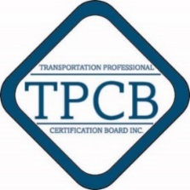
Sponsors
Founders Circle Sponsors
Advocate for Safety
Safety Investor Sponsors
Notes:
FHWA and the Roadway Safety Foundation have generously supported the development of the RSP Level 1.
NHTSA is contributing to the RSP Level 2 development along with other sponsoring organizations and companies.
TPCB is seeking additional contributions to fully fund the RSP Level 2 development.

Slide 21

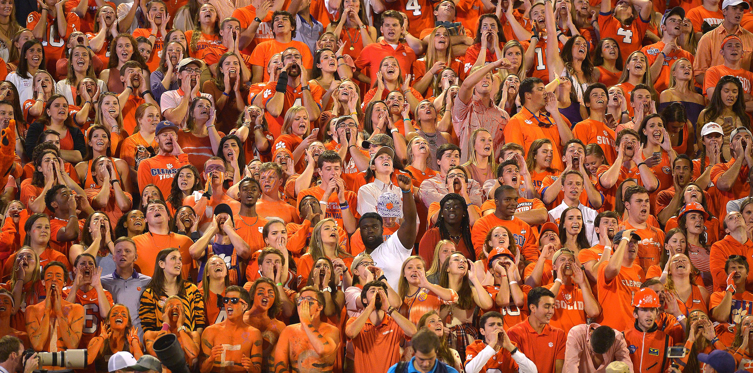

Newest Member of the RSP Founder’s Circle Circle

Slide 22



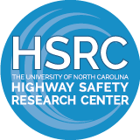


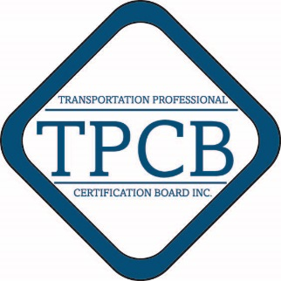


Supporting Organizations
Notes:
FHWA and the Roadway Safety Foundation have generously supported the development of the RSP Level 1.
NHTSA is contributing to the RSP Level 2 development along with other sponsoring organizations and companies.
TPCB is seeking additional contributions to fully fund the RSP Level 2 development.

Slide 23
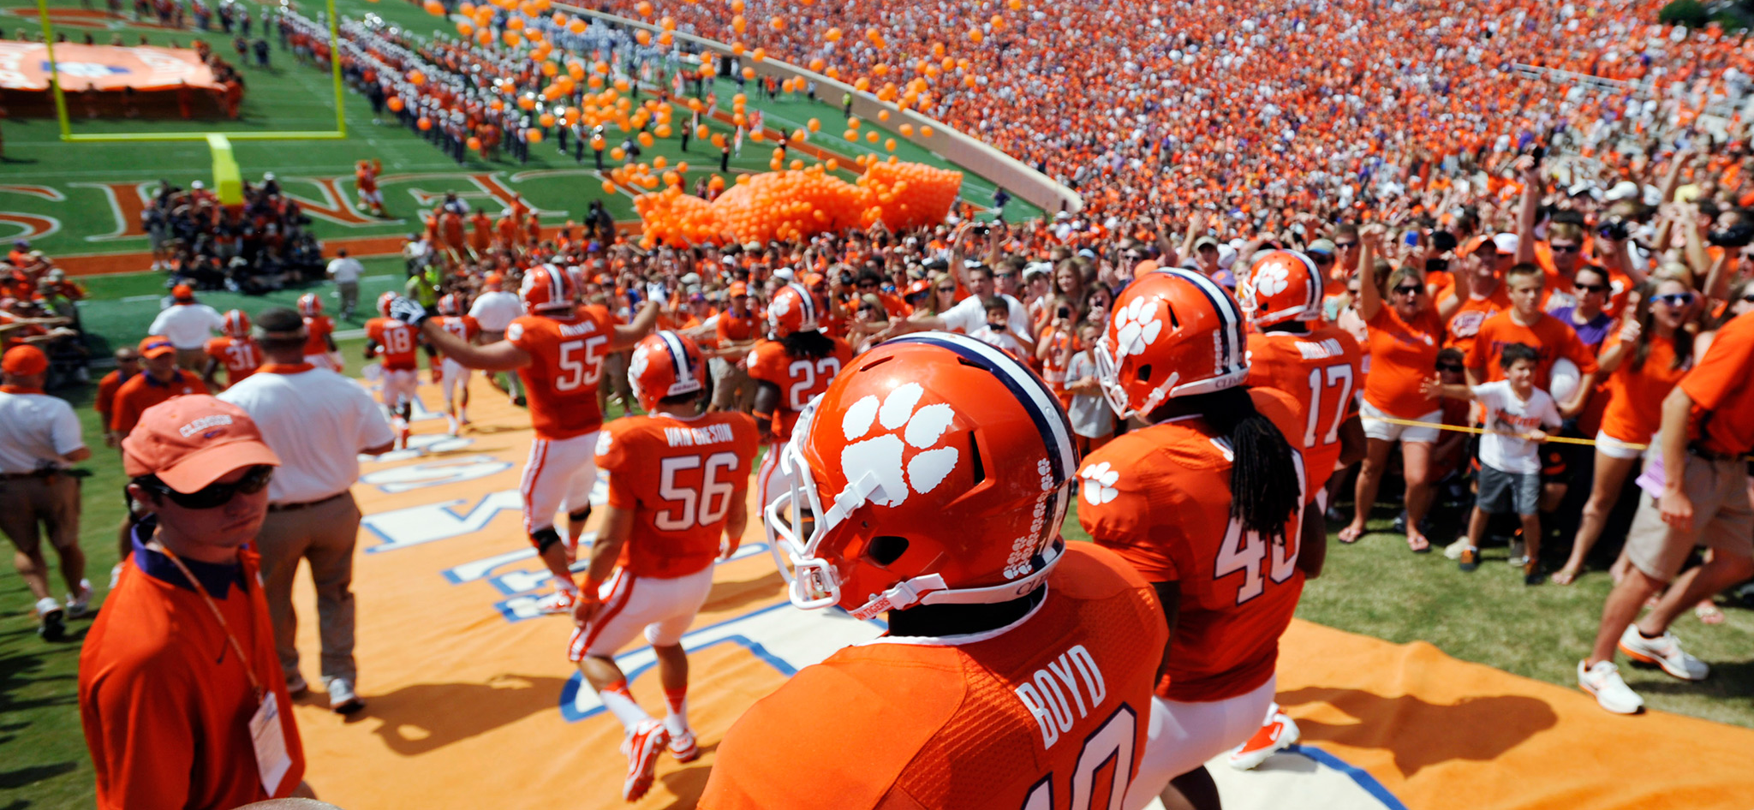
IGRSS - Newest RSP Advocate for Safety

Slide 24
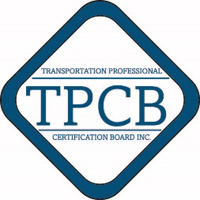
For more information
Visit tpcb.org
Certification:
  Ann O’Neill, aoneill@tpcb.org, 202-464-6213
Sponsorship:
  Pam Goodell, pgoodell@ite.org, 202-464-6228
Notes:
For more information on the RSP visit the TPCB web site or contact one of the TPCB staff.

